Slide 1
Artificial Intelligence and Machine Learning
MCA 203
Pre-requisite based Study Material

Slide 2
Pre- Requisite Modules
An Introduction to Artificial Intelligence by Prof. Mausam, IIT Delhi, Link: https://nptel.ac.in/courses/106/102/106102220/
Machine Learning, NPTEL by Prof. Prof. Carl Gustaf Jansson, Department of Computer Science and Engineering, KTH Royal Institute of Technology, Sweden, Link: https://nptel.ac.in/courses/106/106/106106202/#
Artificial Intelligence: Knowledge Representation and Reasoning by Prof. Deepak Khemant, IIT Madras, Link: https://nptel.ac.in/courses/106/106/106106140/
Lecture Slides
Pre-requisite based Study Material, Artificial Intelligence and Machine Learning, by Dr. Ritika Wason

Slide 3
Mathematical Logic
Definition: Methods of reasoning, provides rules and techniques to determine whether an argument is valid
Theorem: a statement that can be shown to be true (under certain conditions)
  Example: If x is an even integer, then x + 1 is an odd integer
    This statement is true under the condition that x is an integer is true

Slide 4
Mathematical Logic
A statement, or a proposition, is a declarative sentence
that is either true or false, but not both
Uppercase letters denote propositions
  Examples:
    P: 2 is an even number (true)
    Q: 7 is an even number (false)
    R: A is a vowel (true)
  The following are not propositions:
    P: My cat is beautiful
    Q: My house is big

Slide 5
Propositions
A statement that has a truth value
Which of the following are propositions?
  The Washington State flag is red
  It snowed in Whistler, BC on January 4, 2008.
  Hillary Clinton won the democratic caucus in Iowa
  Space aliens landed in Roswell, New Mexico
  Ron Paul would be a great president
  Turn your homework in on Wednesday
  Why are we taking this class?
  If n is an integer greater than two, then the equation a^{n} + b^{n}
= c^{n} has no solutions in non-zero integers a, b, and c.
  Every even integer greater than two can be written as the sum of two primes
  This statement is false
Propositional variables: p, q, r, s, . . .
Truth values: T for true, F for false

Slide 6
Mathematical Logic
Truth value
  One of the values “truth” (T) or “falsity” (F)
assigned to a statement
Negation
The negation of P, written
¬P, is the statement
obtained by negating statement P
Example:
  P: A is a consonant
  ¬P: it is the case that A is not a consonant
Truth Table
P
¬P
T F
F T

Slide 7
Mathematical Logic
Conjunction
  Let P and Q be statements.The conjunction of P and Q, written P ^ Q , is the statement formed by joining statements P and Q using the word “and”
  The statement P ^ Q is true if both p and q are true; otherwise P ^ Q is false
  Truth Table for Conjunction:
P | Q | P ˄ Q
F | F | F
F | T | F
T | F | F
T | T | T

Slide 8
Mathematical Logic
Disjunction
  Let P and Q be statements. The disjunction of P and Q, written P v Q , is the statement formed by joining statements P and Q using the word “or”
  The statement P v Q is true if at least one of the
statements P and Q is true; otherwise P v Q is false
  The symbol v is read “or”
  Truth Table for Disjunction:
P | Q | P ˅ Q
F | F | F
F | T | T
T | F | T
T | T | T

Slide 9
Mathematical Logic
Implication
  Let P and Q be statements.The statement “if P then Q” is called an implication or condition.
  The implication “if P then Q” is written P → Q
  P is called the hypothesis, Q is called the conclusion
Truth Table for Implication:
P | Q | P → Q
F | F | T
F | T | F
T | F | T
T | T | T

Slide 10
Mathematical Logic
Implication
  Let P: Today is Sunday and Q: I will wash the car.
  P → Q :
If today is Sunday, then I will wash the car
  The converse of this implication is written Q → P
If I wash the car, then today is Sunday
The inverse of this implication is
¬P → ¬Q
If today is not Sunday, then I will not wash the car
The contrapositive of this implication is ¬Q → ¬P
If I do not wash the car, then today is not Sunday

Slide 11
Mathematical Logic
Biimplication
Let P and Q be statements. The statement “P if and only if
Q” is called the biimplication or biconditional of P and Q
The biconditional “P if and only if Q” is written P ↔ Q
“P if and only if Q”
Truth Table for the Biconditional:
P | Q | P ↔ Q
F | F | T
F | T | F
T | F | F
T | T | T

Slide 12
Mathematical Logic
Precedence of logical connectives is:
  ¬ highest
  ^ second highest
  v third highest
  → fourth highest
  ↔ fifth highest

Slide 13
English and Logic
You cannot ride the roller coaster if you are under 4 feet tall unless you are older than 16 years old
  q: you can ride the roller coaster
  r: you are under 4 feet tall
  s: you are older than 16
( r ∧ ¬ s) → ¬ q
¬ s → (r → ¬ q)

Slide 14
Mathematical Logic
A compound proposition is a
Tautology if it is always true
Contradiction if it is always false
Contingency if it can be either true or false

Slide 15
Mathematical Logic
Logically Implies
  A statement formula A is said to logically imply a statement formula B if the statement formula A → B is a tautology. If A logically implies B, then symbolically we write A → B
Logically Equivalent
  A statement formula A is said to be logically equivalent
to a statement formula B if the statement formula
A ↔ B is a tautology. If A is logically equivalent to B , then symbolically we write A ⇔ B

Slide 16
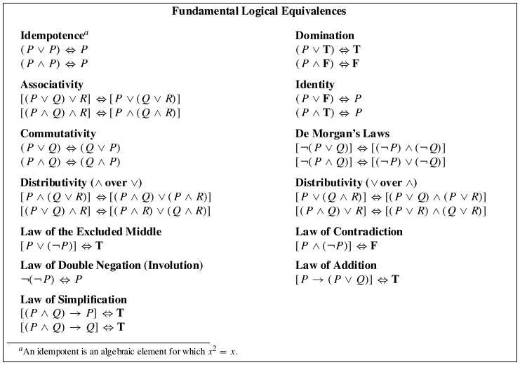

Slide 17
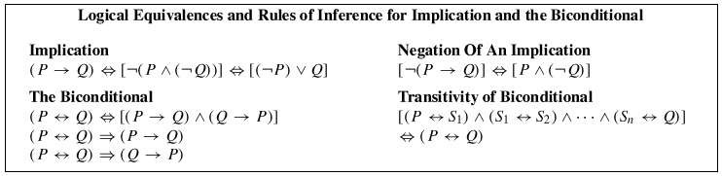
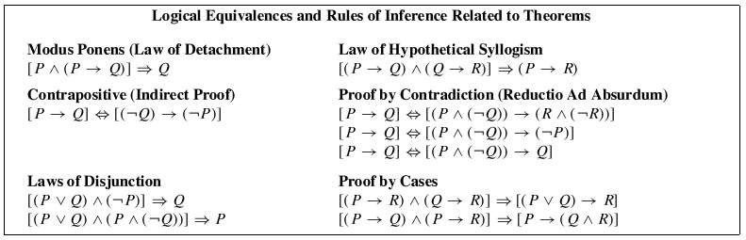

Slide 18
Quantifiers and First Order Logic
Predicate or Propositional Function
  Let x be a variable and D be a set; P(x) is a sentence
  Then P(x) is called a predicate or propositional function with respect to the set D if for each value of x in D, P(x) is a statement; i.e., P(x) is true or false
  Moreover, D is called the domain (universe) of discourse and x is called the free variable

Slide 19
Quantifiers and First Order Logic
Universal Quantifier
  Let P(x) be a predicate and let D be the domain of the discourse. The universal quantification of P(x) is the statement:
    For all x, P(x) or
    For every x, P(x)
    The symbol ∀ is read as “for all and every”
∀x, P(x)
or
∀x ∈ D, P(x)
Two-place predicate: ∀x,∀y, P(x, y)

Slide 20
Quantifiers and First Order Logic
Existential Quantifier
  Let P(x) be a predicate and let D be the universe of discourse. The existential quantification of P(x) is the statement:
    There exists x, P(x)
    The symbol ∃ is read as “there exists”
∃x∈ D, P(x)
or
∃x, P(x)
Bound Variable
  The variable appearing in:∀x, P(x) or ∃x, P(x)

Slide 21
Quantifiers and First Order Logic
Negation of Predicates (DeMorgan’s Laws)
  ¬∀x, P(x) ⇔ ∃x, ¬P(x)
  Example:
    If P(x) is the statement “x has won a race” where the domain of discourse is all runners, then the universal quantification of P(x) is ∀x, P(x) , i.e., every runner has won a race. The negation of this statement is “it is not the case that every runner has won a race. Therefore there exists at least one runner who has not won a race.
Therefore:
∃x, ¬P(x)
●
¬∃x, P(x) ⇔ ∀x, ¬P(x)

Slide 22
Introduction to Linear Algebra

Slide 23
Part 1: Matrix Arithmetic
(w/applications to neural networks)

Slide 24
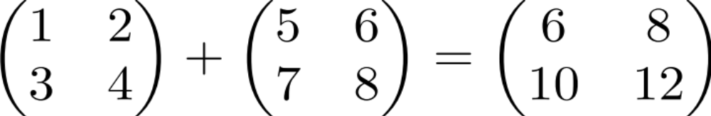
Matrix addition

Slide 25

Scalar times vector

Slide 26

Scalar times vector

Slide 27
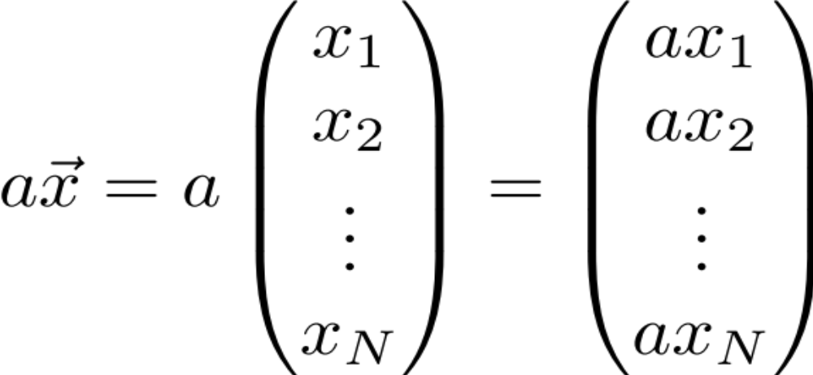
Scalar times vector

Slide 28
Product of 2 Vectors
Three ways to multiply
Element-by-element
Inner product
Outer product

Slide 29
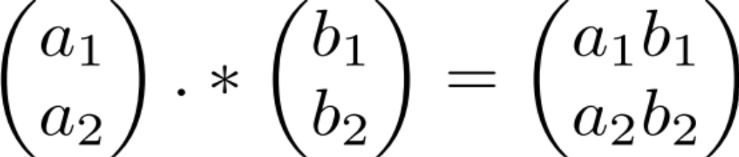
Element-by-element product (Hadamard product)
Element-wise multiplication (.* in MATLAB)

Slide 30
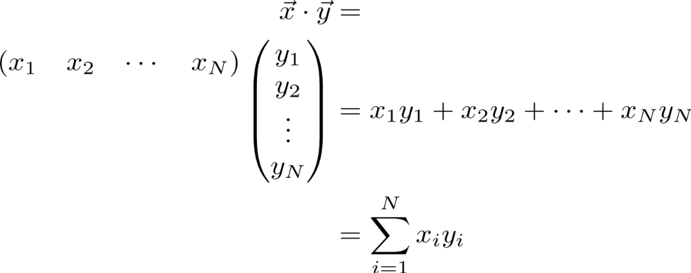
Multiplication:
Dot product (inner product)

Slide 31
Multiplication:
Dot product (inner product)

Slide 32
Multiplication:
Dot product (inner product)

Slide 33
Multiplication:
Dot product (inner product)

Slide 34
Multiplication:
Dot product (inner product)
1 X N
N X 1
1 X 1
MATLAB: ‘inner matrix dimensions must agree’
Outer dimensions give
size of resulting matrix

Slide 35



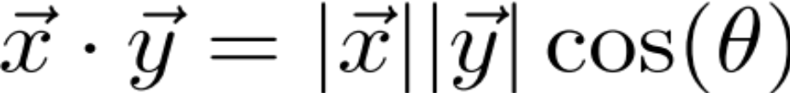
Dot product geometric intuition:
“Overlap” of 2 vectors

Slide 36
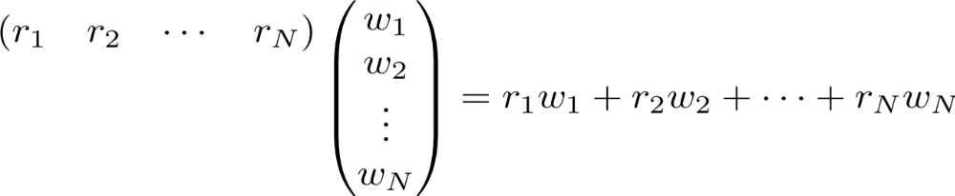
Example: linear feed-forward network
Input neurons’
Firing rates
r₁
r₂
r_{i}
r_{n}

Slide 37
Example: linear feed-forward network
Input neurons’
Firing rates
r₁
Synaptic weights
r₂
r_{i}
r_{n}

Slide 38
Example: linear feed-forward network
Input neurons’
Firing rates
r₁
Synaptic weights
r₂
Output neuron’s
firing rate
r_{i}
r_{n}

Slide 39



Example: linear feed-forward network
Input neurons’
Firing rates
Insight: for a given input (L2) magnitude, the response is maximized when the input is parallel to the weight vector
Receptive fields also can be thought of this way
r₁
Synaptic weights
r₂
Output neuron’s
firing rate
r_{i}
r_{n}

Slide 40
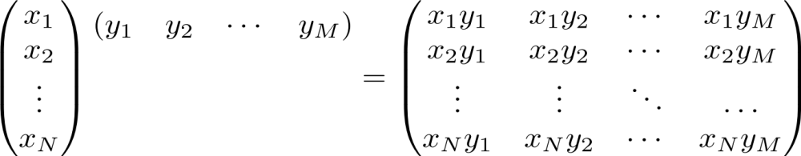
Multiplication: Outer product
N X 1
1 X M
N X M

Slide 41
Multiplication: Outer product

Slide 42
Multiplication: Outer product

Slide 43
Multiplication: Outer product

Slide 44
Multiplication: Outer product

Slide 45
Multiplication: Outer product

Slide 46

Multiplication: Outer product

Slide 47
Multiplication: Outer product
Note: each column or each row is a multiple of the others
Notes:
We’ll see implications of this feature shortly… (motivation for “rank 1”/1-dimensional matrix) and also underlying components of SVD

Slide 48
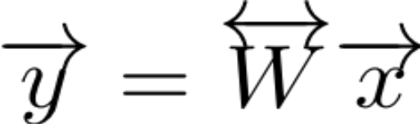
Matrix times a vector

Slide 49
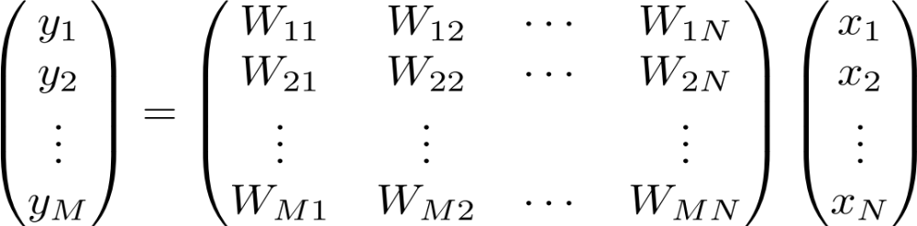
Matrix times a vector

Slide 50
Matrix times a vector
M X 1
M X N
N X 1

Slide 51
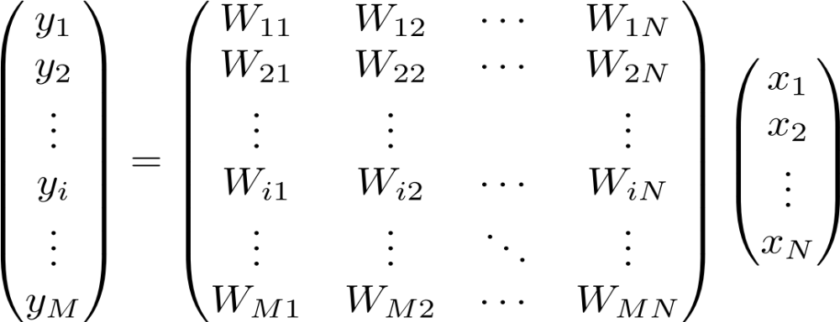
Matrix times a vector: inner product interpretation
Rule: the i^{th} element of y is the dot product of the i^{th} row of W with x

Slide 52
Matrix times a vector: inner product interpretation
Rule: the i^{th} element of y is the dot product of the i^{th} row of W with x

Slide 53
Matrix times a vector: inner product interpretation
Rule: the i^{th} element of y is the dot product of the i^{th} row of W with x

Slide 54
Matrix times a vector: inner product interpretation
Rule: the i^{th} element of y is the dot product of the i^{th} row of W with x

Slide 55

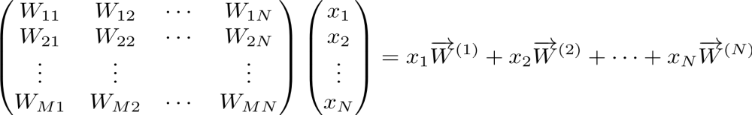
Matrix times a vector: outer product interpretation
The product is a weighted sum of the columns of W, weighted by the entries of x

Slide 56
Matrix times a vector: outer product interpretation
The product is a weighted sum of the columns of W, weighted by the entries of x

Slide 57
Matrix times a vector: outer product interpretation
The product is a weighted sum of the columns of W, weighted by the entries of x

Slide 58
Matrix times a vector: outer product interpretation
The product is a weighted sum of the columns of W, weighted by the entries of x

Slide 59
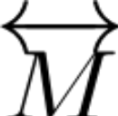
Example of the outer product method

Slide 60
Example of the outer product method
(0,2)
(3,1)

Slide 61
Example of the outer product method
(0,4)
(3,1)

Slide 62
Example of the outer product method
(3,5)
Note: different combinations of the columns of M can give you any vector in the plane
(we say the columns of M
“span” the plane)

Slide 63
Rank of a Matrix
Are there special matrices whose columns don’t span the full plane?

Slide 64
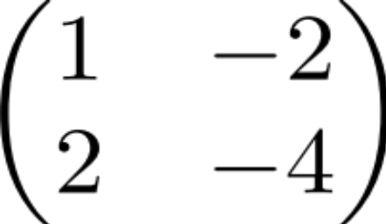
Rank of a Matrix
Are there special matrices whose columns don’t span the full plane?
(1,2)
(-2, -4)
You can only get vectors along the (1,2) direction (i.e. outputs live in 1 dimension, so we call the matrix rank 1)
Notes:
Such rank 1 matrices can be written as an outer product, e.g. in this case as (1 2)’ * (1 -2)

Slide 65



Example: 2-layer linear network
W_{ij} is the connection strength (weight) onto neuron y_{i} from neuron x_{j}.

Slide 66
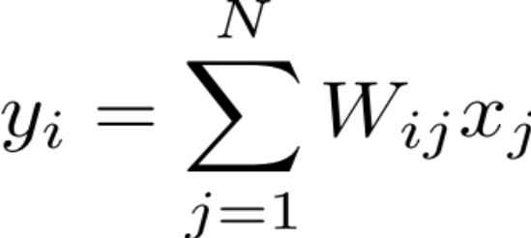

Example: 2-layer linear network: inner product point of view
What is the response of cell y_{i} of the second layer?
The response is the dot product of the i^{th} row of W with the vector x

Slide 67

Example: 2-layer linear network: outer product point of view
How does cell x_{j} contribute to the pattern of firing of layer 2?
1st column
of W
Contribution
of x_{j} to
network output

Slide 68
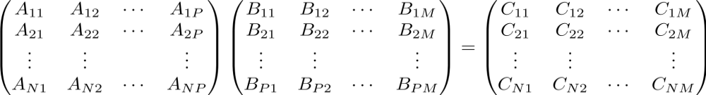
Product of 2 Matrices
N X P
P X M
N X M
MATLAB: ‘inner matrix dimensions must agree’
Note: Matrix multiplication doesn’t (generally) commute, AB ≠ BA

Slide 69
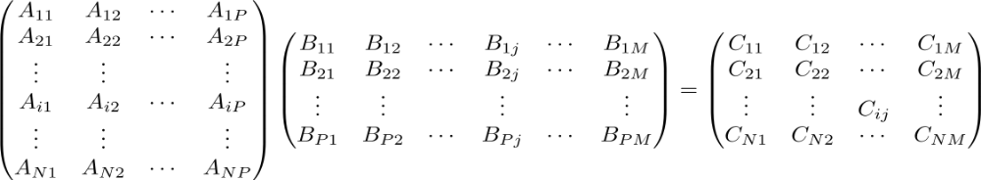
Matrix times Matrix: by inner products
C_{ij} is the inner product of the i^{th} row with the j^{th} column

Slide 70
Matrix times Matrix: by inner products
C_{ij} is the inner product of the i^{th} row with the j^{th} column

Slide 71
Matrix times Matrix: by inner products
C_{ij} is the inner product of the i^{th} row with the j^{th} column

Slide 72
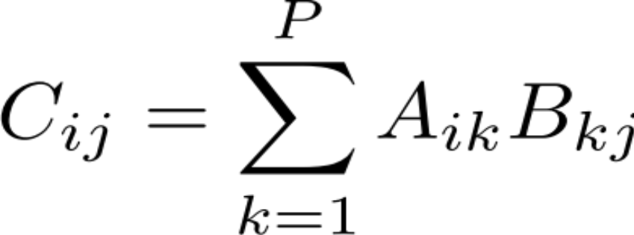
Matrix times Matrix: by inner products
C_{ij} is the inner product of the i^{th} row of A with the j^{th} column of B

Slide 73
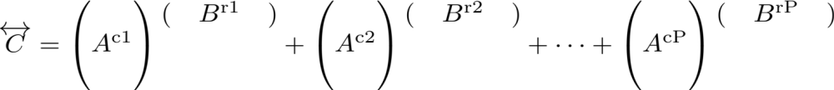
Matrix times Matrix: by outer products

Slide 74
Matrix times Matrix: by outer products

Slide 75
Matrix times Matrix: by outer products

Slide 76
Matrix times Matrix: by outer products
C is a sum of outer products of the columns of A with the rows of B
Notes:
Note: this way of matrix multiplying, i.e. breaking into outer products is key to Singular Value Decomposition (SVD) which I’ll discuss at end of lecture; note that each outer product is rank 1 since each column (or row) is a multiple of every other column (or row)

Slide 77
Part 2: Matrix Properties
(A few) special matrices
Matrix transformations & the determinant
Matrices & systems of algebraic equations

Slide 78
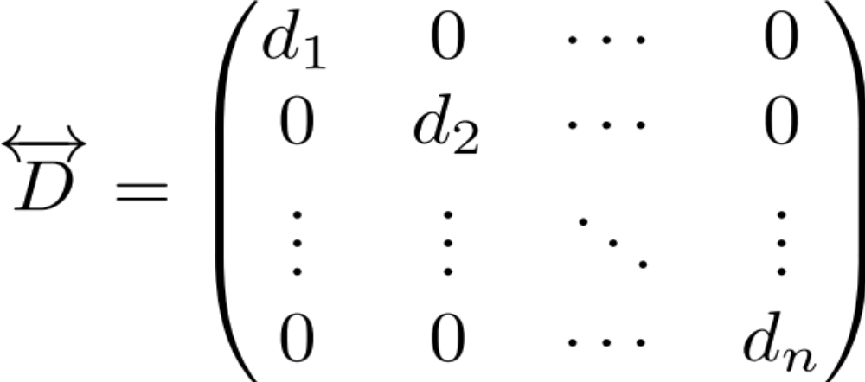
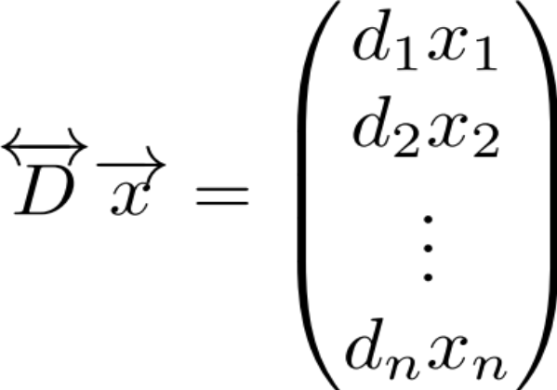
Special matrices: diagonal matrix
This acts like scalar multiplication

Slide 79
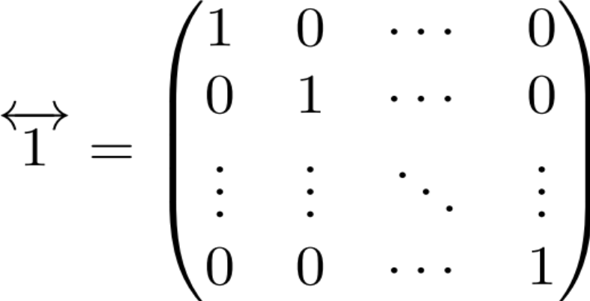
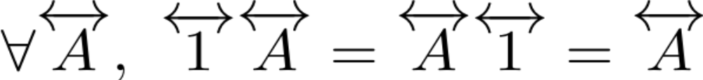
Special matrices: identity matrix
for all

Slide 80
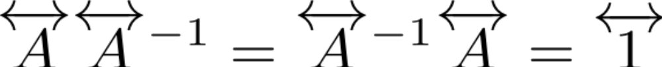
Special matrices: inverse matrix
Does the inverse always exist?
Notes:
For scalars, there is no inverse if the scalar’s value is 0. For matrices, the corresponding quantity that has to be nonzero for the inverse to exist is called the determinant, which we’ll show next corresponds geometrically (up to a sign) to an area (or, in higher dimensions, volume).

Slide 81
How does a matrix transform a square?
(0,1)
(1,0)

Slide 82
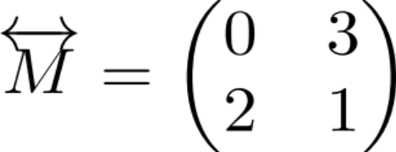
How does a matrix transform a square?
(0,1)
(1,0)

Slide 83
How does a matrix transform a square?
(0,2)
(0,1)
(3,1)
(1,0)
Notes:
Note, potentially a bit confusing: the vector (1,0) got mapped into (0,2) and (0,1) got mapped into (3,1): this relates to fact that determinant is negative (i.e. in some sense, orientation of parallelogram flipped)

Slide 84
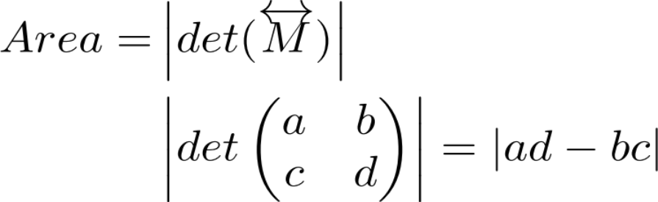
Geometric definition of the determinant: How does a matrix transform a square?
(0,1)
(1,0)

Slide 85
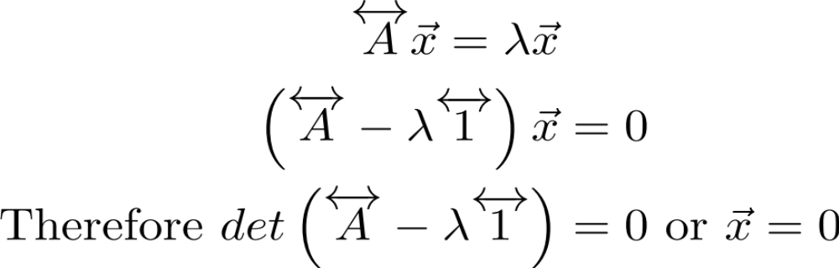
Example: solve the algebraic equation

Slide 86
Example: solve the algebraic equation

Slide 87
Example: solve the algebraic equation
⇒
Notes:
If above determinant is zero, then inverse doesn’t exist and can’t conclude that x=0 by simply multiplying both sides of the equation by the inverse.

Slide 88
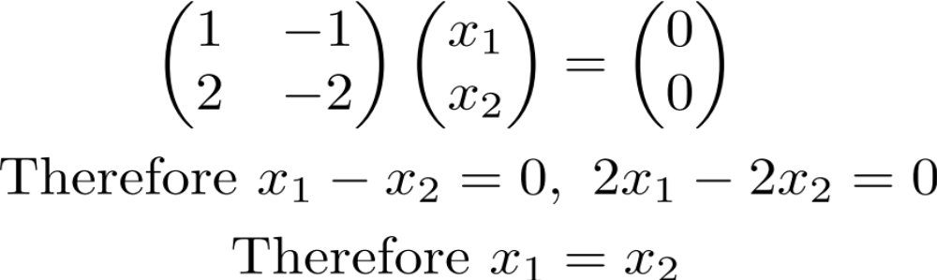
Example of an underdetermined system
Some non-zero vectors are sent to 0

Slide 89
Example of an underdetermined system
Some non-zero vectors are sent to 0

Slide 90
Example of an underdetermined system
⇒

Slide 91
Example of an underdetermined system
⇒
Some non-zero x are sent to 0 (the set of all x with Mx=0 are called the “nullspace” of M)
This is because det(M)=0 so M is not invertible. (If det(M) isn’t 0, the only solution is x = 0)
Notes:
c

Slide 92
Part 3: Eigenvectors & eigenvalues

Slide 93
What do matrices do to vectors?
(0,2)
(2,1)
(3,1)

Slide 94
Recall
(3,5)
(2,1)

Slide 95
What do matrices do to vectors?
(3,5)
The new vector is:
1) rotated
2) scaled
(2,1)

Slide 96
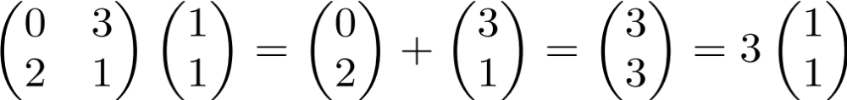
Are there any special vectors that only get scaled?

Slide 97
Are there any special vectors that only get scaled?
Try (1,1)

Slide 98
Are there any special vectors that only get scaled?
= (1,1)

Slide 99
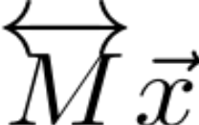
Are there any special vectors that only get scaled?
= (3,3)
= (1,1)

Slide 100
Are there any special vectors that only get scaled?
For this special vector, multiplying by M is like multiplying by a scalar.
(1,1) is called an eigenvector of M
3 (the scaling factor) is called the eigenvalue associated with this eigenvector
= (3,3)
= (1,1)

Slide 101
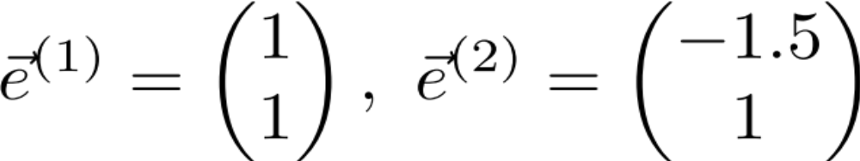
Are there any other eigenvectors?
Yes! The easiest way to find is with MATLAB’s eig command.
Exercise: verify that (-1.5, 1) is also an eigenvector of M.
Note: eigenvectors are only defined up to a scale factor.
  Conventions are either to make e’s unit vectors, or make one of the elements 1

Slide 102
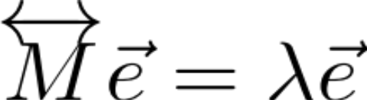
Step back:
Eigenvectors obey this equation

Slide 103
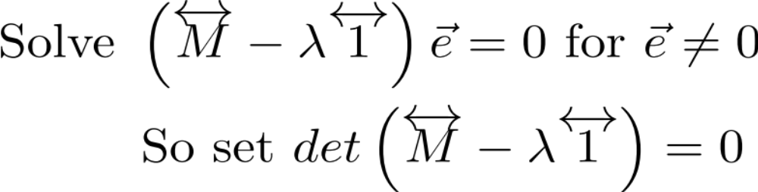
Step back:
Eigenvectors obey this equation

Slide 104
Step back:
Eigenvectors obey this equation

Slide 105
Step back:
Eigenvectors obey this equation
This is called the characteristic equation for λ
In general, for an N x N matrix, there are N eigenvectors

Slide 106
Part 4: Examples (on blackboard)
Principal Components Analysis (PCA)
Single, linear differential equation
Coupled differential equations

Slide 107
Part 5: Recap & Additional useful stuff
Matrix diagonalization recap:
transforming between original & eigenvector coordinates
More special matrices & matrix properties
Singular Value Decomposition (SVD)

Slide 108
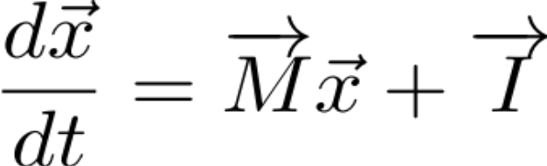

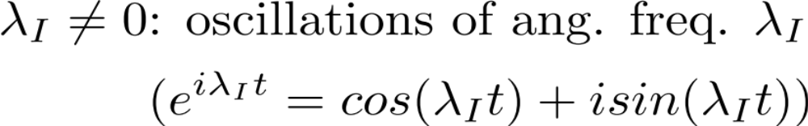
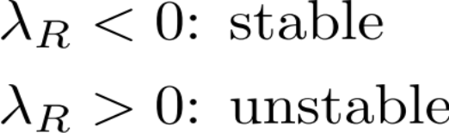
Coupled differential equations
Calculate the eigenvectors and eigenvalues.
  Eigenvalues have typical form:
The corresponding eigenvector component has dynamics:

Slide 109
Practical program for approaching equations coupled through a term Mx
Step 1: Find the eigenvalues and eigenvectors of M.
Step 2: Decompose x into its eigenvector components
Step 3: Stretch/scale each eigenvalue component
Step 4: (solve for c and) transform back to original coordinates.
eig(M) in MATLAB

Slide 110
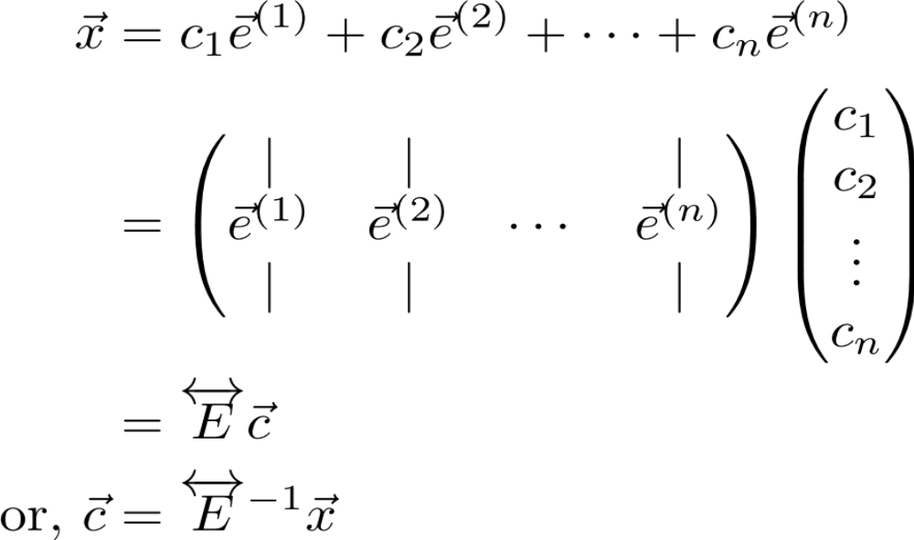
Practical program for approaching equations coupled through a term Mx
Step 1: Find the eigenvalues and eigenvectors of M.
Step 2: Decompose x into its eigenvector components
Step 3: Stretch/scale each eigenvalue component
Step 4: (solve for c and) transform back to original coordinates.

Slide 111
Practical program for approaching equations coupled through a term Mx
Step 1: Find the eigenvalues and eigenvectors of M.
Step 2: Decompose x into its eigenvector components
Step 3: Stretch/scale each eigenvalue component
Step 4: (solve for c and) transform back to original coordinates.

Slide 112
Practical program for approaching equations coupled through a term Mx
Step 1: Find the eigenvalues and eigenvectors of M.
Step 2: Decompose x into its eigenvector components
Step 3: Stretch/scale each eigenvalue component
Step 4: (solve for c and) transform back to original coordinates.
Notes:
Step 4: (solve for c and) transform back to original coordinates.

Slide 113
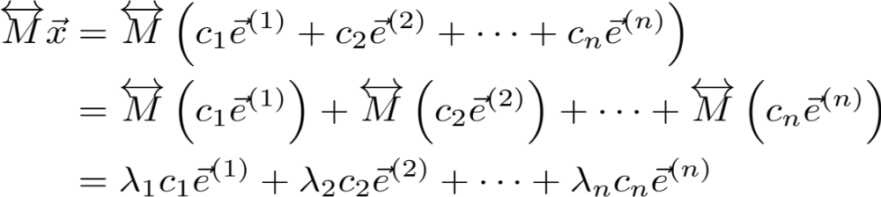
Practical program for approaching equations coupled through a term Mx
Step 1: Find the eigenvalues and eigenvectors of M.
Step 2: Decompose x into its eigenvector components
Step 3: Stretch/scale each eigenvalue component
Step 4: (solve for c and) transform back to original coordinates.

Slide 114
Practical program for approaching equations coupled through a term Mx
Step 1: Find the eigenvalues and eigenvectors of M.
Step 2: Decompose x into its eigenvector components
Step 3: Stretch/scale each eigenvalue component
Step 4: (solve for c and) transform back to original coordinates.

Slide 115
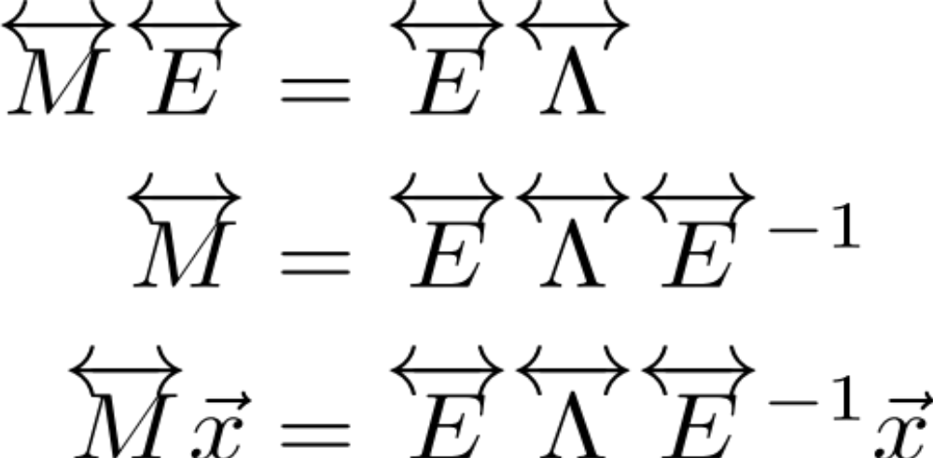
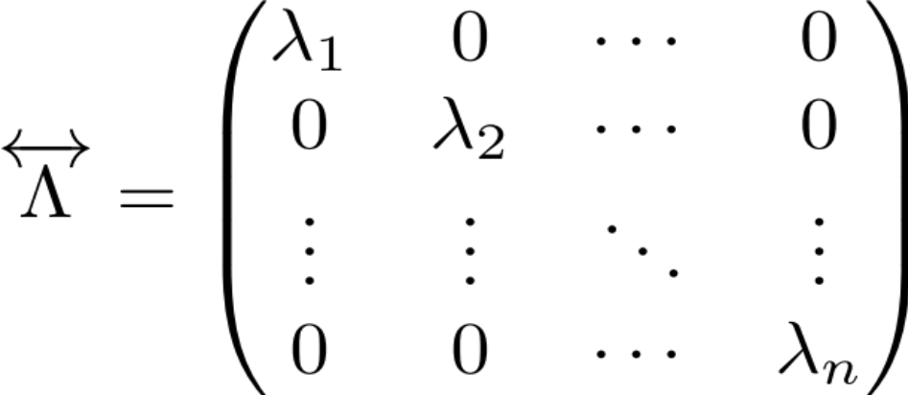
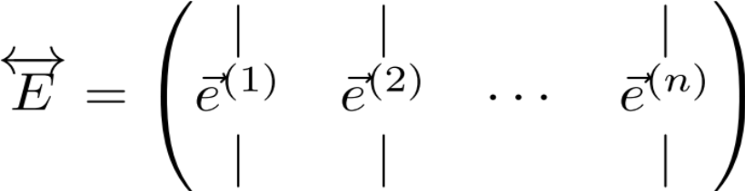
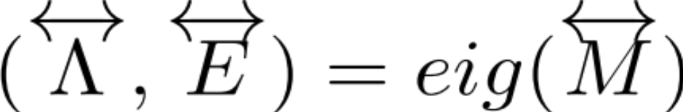
Putting it all together…
Where (step 1):
MATLAB:

Slide 116
Putting it all together…
Step 2: Transform into eigencoordinates
Step 4: Transform back to original coordinate system
Step 3: Scale by λ_{i} along the i^{th} eigencoordinate

Slide 117
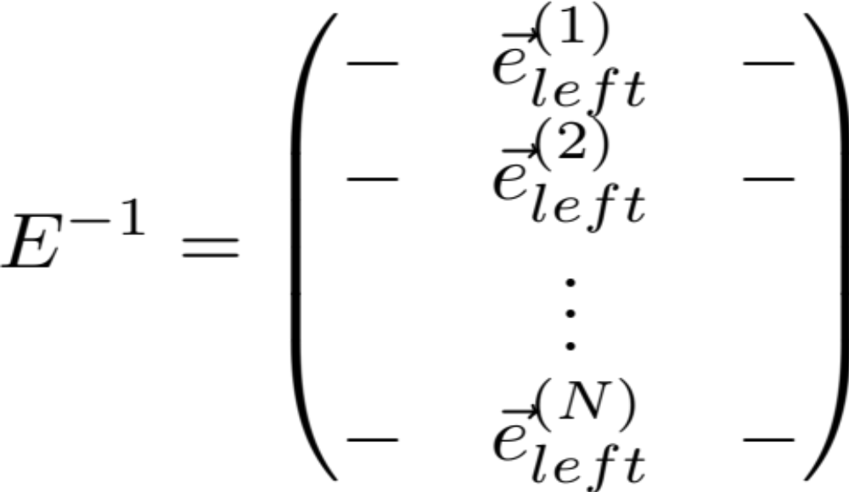
Left eigenvectors
-The rows of E inverse are called the left eigenvectors
because they satisfy E⁻¹ M = Λ E⁻¹.
-Together with the eigenvalues, they determine how x is decomposed into each of its eigenvector components.
Notes:
Notes:
1) sometimes left eigenvectors are called adjoint eigenvectors
2) later we’ll show that in some cases the right and left eigenvectors are the same (Normal matrices). It is easily shown that they obey the equation:
e_left M = lambda * e_left, i.e. they are analogous to the usual (right) eigenvectors except that they multiply M from the *left* (and they must be written as row vectors to do this).
Proof (can do on board): M = E*Lambda*E^(-1)
E^(-1) M = Lambda*E^(-1)
3) the left eigenvectors of M transpose are the same as the right eigenvectors of M
Proof: M*E = E * Lambda
E’ * M’ = Lambda * E’ (i.e. rows of E’ are the left eigenvectors of M’, and are identical to columns of E)
4) Even though eigenvectors are not necessarily orthogonal, left & right eigenvectors corresponding to distinct eigenvalues are orthogonal
Proof: follows directly from E^(-1) * E = Identity
.

Slide 118
Putting it all together…
Original Matrix
Matrix in eigencoordinate system
Where:

Slide 119
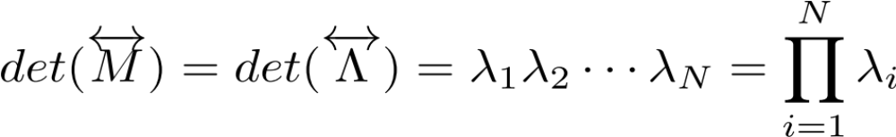
Trace and Determinant
Original Matrix
Matrix in eigencoordinate system
Note: M and Lambda look very different.
Q: Are there any properties that are preserved between them?
A: Yes, 2 very important ones:
1.
2.

Slide 120
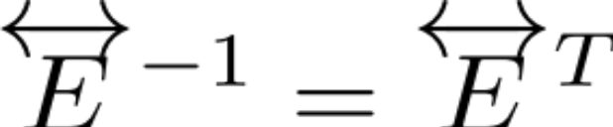
Special Matrices: Normal matrix
Normal matrix: all eigenvectors are orthogonal
→ Can transform to eigencoordinates (“change basis”) with a simple rotation* of the coordinate axes
→ A normal matrix’s eigenvector matrix E is a *generalized rotation (unitary or orthonormal) matrix, defined by:
Picture:
E
(*note: generalized means one can also do reflections of the eigenvectors through a line/plane”)
Notes:
Key feature: if decomposing a general vector into components in an orthonormal coordinate system, then do this through simple orthogonal projection along the orthonormal axes of the coordinate system. This can be done through a dot product (as noted near the beginning of this tutorial…). Since transforming into the eigenvector coordinate system is accomplished by a dot product with the rows of E^(-1), we see that this operation is simply a dot product with the eigenvectors when we have E^(-1) = E transpose.
Note: reflections could technically be through any axis, because one can then rotate more to make up for which axis one reflected through. Note that performing reflection changes the sign of the determinant (e.g. from =1 to -1). [Aside/not relevant here but for cultural interest: Unitary or orthonormal matrices that are restricted to have positive determinant (= +1) are called “special unitary” or “special orthonormal” matrices.] Also note that the absolute value of the determinant equaling 1 for unitary/orthonormal matrices reflects the earlier comment that determinants give the area of the transformation of a unit square, and a rotation matrix is area-preserving.

Slide 121
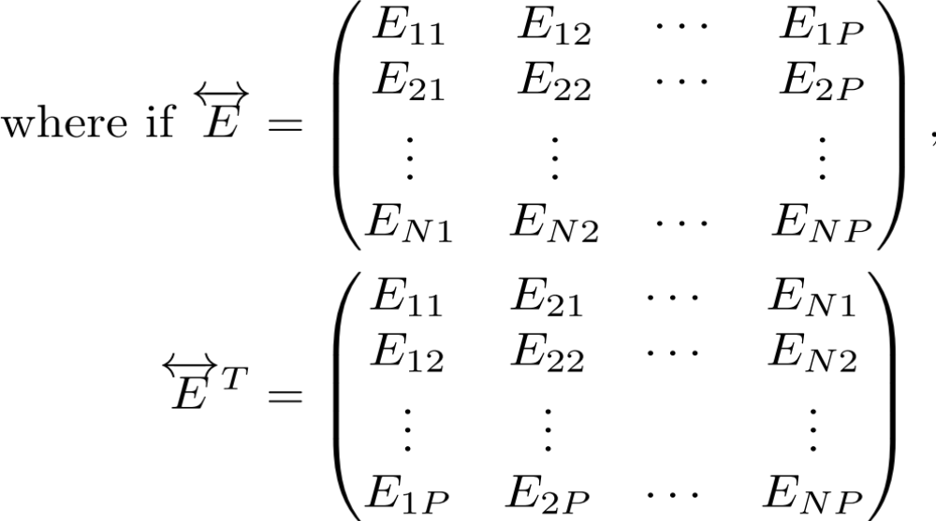
Special Matrices: Normal matrix
Normal matrix: all eigenvectors are orthogonal
→ Can transform to eigencoordinates (“change basis”) with a simple rotation of the coordinate axes
→ E is a rotation (unitary or orthogonal) matrix, defined by:
where if:
then:

Slide 122
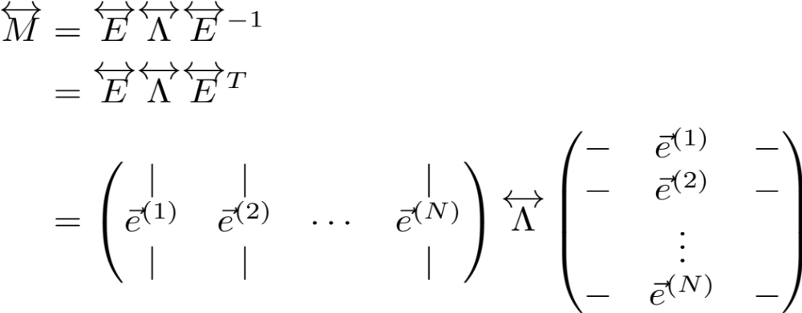
Special Matrices: Normal matrix
Eigenvector decomposition in this case:
Left and right eigenvectors are identical!

Slide 123
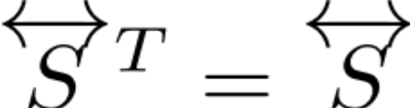
Special Matrices
Symmetric Matrix:
e.g. Covariance matrices, Hopfield network
Properties:
  Eigenvalues are real
  Eigenvectors are orthogonal (i.e. it’s a normal matrix)
Notes:
Proof that eigvals real: Suppose Av = (lambda)v, where lambda potentially complex and A = A’ (‘ denotes transpose) and A real-valued
Consider v’*Av = v’*(Av) = lambda v’*v = lambda |v|^2, where * denotes complex conjugate (NOT multiplication)
but also v’*Av = (v’*A)v = (A’v*)’v = (Av*)’v = lambda* |v|^2
Thus, lambda = lambda* → lambda real
Proof that eigvectors orthogonal: now consider two eigenvectors v and w with distinct eigenvalues
Consider v’Aw two ways above to see that v’w must equal zero
Note: covariance matrices have further restriction that eigenvalues are positive, this results from the fact that covariance matrices are of the form XX’

Slide 124



SVD: Decomposes matrix into outer products
(e.g. of a neural/spatial mode and a temporal mode)
t = 1
t = 2
t = T
n = 1
n = 2
n = N

Slide 125
SVD: Decomposes matrix into outer products
(e.g. of a neural/spatial mode and a temporal mode)
t = 1
t = 2
t = T
n = 1
n = 2
n = N

Slide 126

SVD: Decomposes matrix into outer products
(e.g. of a neural/spatial mode and a temporal mode)
Columns of U are eigenvectors of MM^{T}
Rows of V^{T} are
eigenvectors of M^{T}M
Note: the eigenvalues are the same for M^{T}M and MM^{T}

Slide 127
SVD: Decomposes matrix into outer products
(e.g. of a neural/spatial mode and a temporal mode)
Columns of U are eigenvectors of MM^{T}
Rows of V^{T} are
eigenvectors of M^{T}M
Thus, SVD pairs “spatial” patterns with associated “temporal” profiles through the outer product
Notes:
Note 1: Each neural mode has an associated temporal mode, and that M can be written as a linear sum of outer products.
Note 2: Alternatively, the time course of each spatial mode (i.e. the strength of the spatial mode at each point in time) is given by the associated temporal eigenvector times the singular value. Sometimes people refer to each temporal eigenvector scaled by its singular value as the temporal ‘component’ to distinguish it from the spatial ‘mode’.
Note 3: remember that outer products are 1d (i.e. rank 1)
Note 4: if you are centering your data, you can subtract off the mean of *either* your rows *or* your columns, but you cannot do both (i.e. first subtract off mean of rows, then subtract off means of resulting columns) or you will lose a dimension. More generally, if you think of your individual data points as occupying either the rows or columns of M, then you want to do the operation that corresponds to subtracting the means of the data points, i.e. “centering the data”; if you do the other mean subtraction, you will see that your data loses a dimension. Try this with a 2x3 matrix, plotting it with the interpretation of its being 3 two-dimensional data points to see what happens if you subtract off the “wrong mean”.

Slide 128
The End

